Slide 1
Galaxy Buds2
Modify
Localization Guide
- P6 Standard feature HTML
Brief date : 29th February, 2024

Slide 2
Adaptation Guideline
Assets have been approved by the HQ legal Office. However, local market MUST check with your local legal team for clearance prior to going to market.
For adaptation of the content, each local office is responsible for translating, subtitling, captioning and uploading of the distributed assets.
Please make sure to follow the guidelines and usage terms when utilizing the assets.
URL structure and naming must not be edited by local. Local language is not allowed.

Slide 3
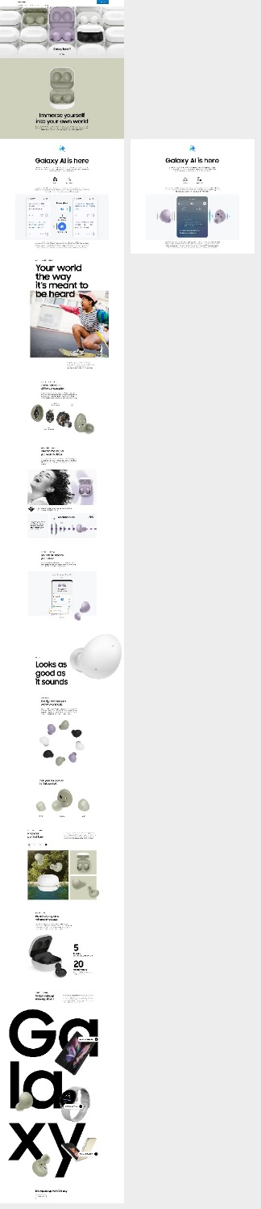
2024 Hotfix Full View
[PC]
[MO]

Slide 4
Localization Guideline

Slide 5
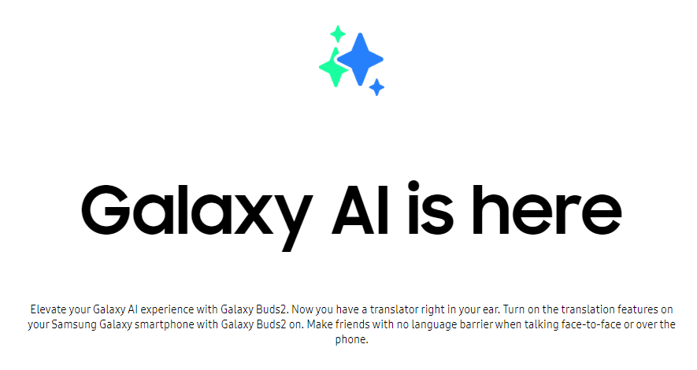
Localization Guideline
Headline
Logo Img url & Title & Description text change
1
2
3
index_pim.html
<div class="sc-buds-ai__headline">
<div class="sc-buds-ai__logo">
<img
class="sc-buds-ai__logo__image"
src="https://images.samsung.com/is/image/samsung/assets/test/mobile/2022-2h/galaxy-buds2/galaxy-buds2-ai-logo.png"
alt=""
/>
</div>
<h2
class="sc-buds-ai__title"
id="tabTitleId_01"
data-font-size-pc="64"
data-font-size-mo="70"
>
Galaxy AI is here
</h2>
<p class="sc-buds-ai__description">
Elevate your Galaxy AI experience with Galaxy Buds2. Now you have a
translator right in your ear. Turn on the translation features on your
Samsung Galaxy smartphone with Galaxy Buds2 on. Make friends with no
language barrier when talking face-to-face or over the phone.
</p>
</div>
1
2
3
3

Slide 6
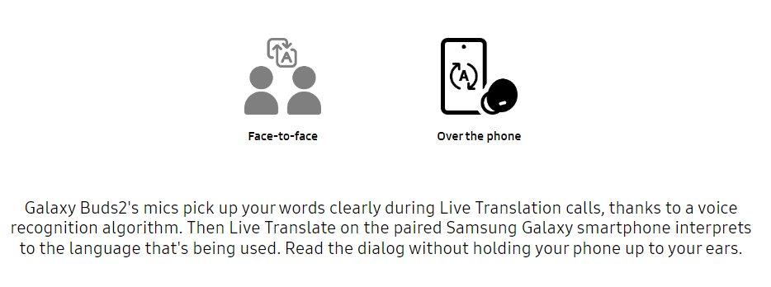
Localization Guideline
Content
List text & Image url change
1
2
index_pim.html
<div
class="sc-buds-ai-list"
role="tablist"
aria-labelledby="tabTitleId_01"
>
<a
class="sc-buds-ai-list__anchor sc-buds-ai-list__anchor--active"
id="tabListId_0"
href="javascript:void(0);"
role="tab"
aria-selected="true"
aria-controls="tabPanelId_0"
onclick="toggleActiveTabPanelAi(this)"
onmouseenter="onActiveAi(this)"
onmouseleave="onInActiveAi(this)"
onkeypress="toggleActiveTabPanelAi(this)"
onfocus="onActiveAi(this)"
onblur="onInActiveAi(this)"
data-omni-type="microsite_contentinter"
data-omni="galaxy ai is here:face to face"
ga-ca="content click"
ga-ac="feature"
ga-la="galaxy ai is here:face to face"
>
<div class="sc-buds-ai-list__inner">
<div class="sc-buds-ai-list__icon">
<img
class="sc-buds-ai-list__image sc-buds-ai-list__image--active sc-buds-ai-list__anchor--active"
src="https://images.samsung.com/is/image/samsung/assets/test/mobile/2022-2h/galaxy-buds2/galaxy-buds2-ai-facetoface-active0.png"
alt=""
/>
<img
class="sc-buds-ai-list__image sc-buds-ai-list__image--default"
src="https://images.samsung.com/is/image/samsung/assets/test/mobile/2022-2h/galaxy-buds2/galaxy-buds2-ai-facetoface-active0.png"
alt=""
/>
</div>
<span class="sc-buds-ai-list__text">Face-to-face</span>
</div>
</a>
<a
class="sc-buds-ai-list__anchor"
id="tabListId_1"
href="javascript:void(0);"
role="tab"
aria-selected="false"
aria-controls="tabPanelId_1"
onclick="toggleActiveTabPanelAi(this)"
onmouseenter="onActiveAi(this)"
onmouseleave="onInActiveAi(this)"
onkeypress="toggleActiveTabPanelAi(this)"
onfocus="onActiveAi(this)"
onblur="onInActiveAi(this)"
data-omni-type="microsite_contentinter"
data-omni="galaxy ai is here:over the phone"
ga-ca="content click"
ga-ac="feature"
ga-la="galaxy ai is here:over the phone"
>
<div class="sc-buds-ai-list__inner">
<div class="sc-buds-ai-list__icon">
<img
class="sc-buds-ai-list__image sc-buds-ai-list__image--active"
src="https://images.samsung.com/is/image/samsung/assets/test/mobile/2022-2h/galaxy-buds2/galaxy-buds2-ai-overthephone-active0.png"
alt=""
/>
<img
class="sc-buds-ai-list__image sc-buds-ai-list__image--default"
src="https://images.samsung.com/is/image/samsung/assets/test/mobile/2022-2h/galaxy-buds2/galaxy-buds2-ai-overthephone-active0.png"
alt=""
/>
</div>
<span class="sc-buds-ai-list__text">Over the phone</span>
</div>
</a>
</div>
1
2

Slide 7
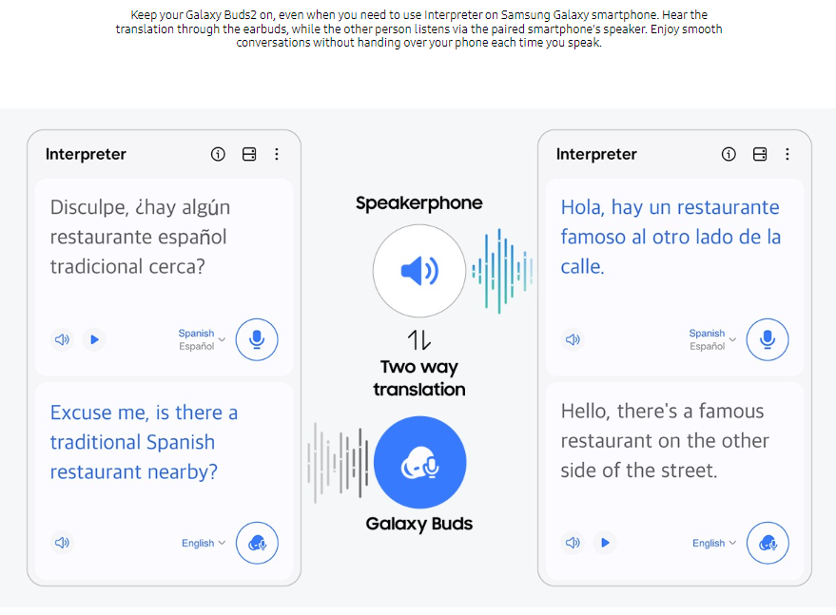
Localization Guideline
Content
1
List Description & Image url change
2
index_pim.html
<div
class="sc-buds-ai-panel sc-buds-ai-panel--active"
id="tabPanelId_0"
role="tabpanel"
aria-hidden="false"
aria-labelledby="tabListId_0"
>
<div class="sc-buds-ai-list__description">
Keep your Galaxy Buds2 on, even when you need to use Interpreter on
Samsung Galaxy smartphone. Hear the translation through the earbuds,
while the other person listens via the paired smartphone's speaker. Enjoy
smooth conversations without handing over your phone each time you speak.
</div>
<figure class="sc-buds-ai-panel__figure">
<div class="image image--main-loaded sc-buds-ai-inner-box">
<img
class="image__main responsive-img image--loaded"
data-desktop-src="https://images.samsung.com/is/image/samsung/assets/test/mobile/2022-2h/galaxy-buds2/galaxy-buds2-ai-facetoface-0305_pc.png"
data-mobile-src="https://images.samsung.com/is/image/samsung/assets/test/mobile/2022-2h/galaxy-buds2/galaxy-buds2-ai-facetoface-0305_mo.png"
alt="GUIs of Interpreter app can be seen, with translated English and Spanish onscreen. Between the GUIs are text and icons that indicate two-way translation through speakerphone and Galaxy Buds."
src="https://images.samsung.com/is/image/samsung/assets/test/mobile/2022-2h/galaxy-buds2/galaxy-buds2-ai-facetoface-0305_pc.png"
/>
</div>
</figure>
1
2

Slide 8
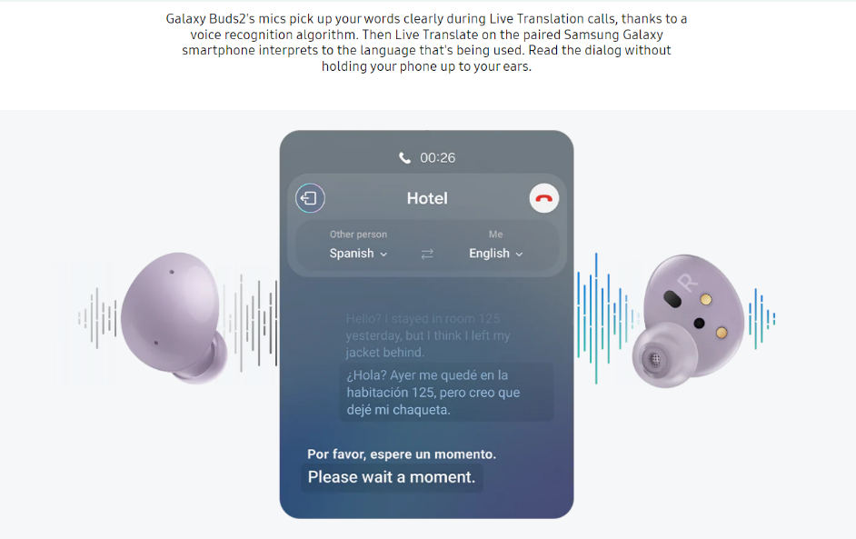
Localization Guideline
Content
1
List Description & Image url change
2
index_pim.html
<div
class="sc-buds-ai-panel"
id="tabPanelId_1"
role="tabpanel"
aria-hidden="true"
aria-labelledby="tabListId_1"
>
<div class="sc-buds-ai-list__description">
Galaxy Buds2&apos;s mics pick up your words clearly during Live
Translation calls, thanks to a voice recognition algorithm. Then Live
Translate on the paired Samsung Galaxy smartphone interprets to the
language that&apos;s being used. Read the dialog without holding your
phone up to your ears.
</div>
<figure class="sc-buds-ai-panel__figure">
<div class="image image--main-loaded sc-buds-ai-inner-box">
<img
class="image__main responsive-img image--loaded"
data-desktop-src="https://images.samsung.com/is/image/samsung/assets/test/mobile/2022-2h/galaxy-buds2/galaxy-buds2-ai-overthephone_pc.png"
data-mobile-src="https://images.samsung.com/is/image/samsung/assets/test/mobile/2022-2h/galaxy-buds2/galaxy-buds2-ai-overthephone_mo.png"
alt="Earbuds of Galaxy Buds2 in Lavendar can be seen. Between the earbuds is GUI of Live Translate. In the background are sound waves that indicate Live Translation."
src="https://images.samsung.com/is/image/samsung/assets/test/mobile/2022-2h/galaxy-buds2/galaxy-buds2-ai-overthephone_pc.png"
/>
</div>
</figure>
1
2

Slide 9
Localization Guideline
Content
Disclaimer change
1
index_pim.html
<span class="sc-buds-ai__disclaimer sc-buds-ai-inner-box"
>*Interpreter feature requires Samsung Account login. Certain
languages may require language pack download. Service availability may
vary by language. Accuracy of results is not guaranteed. *Live
Translate feature requires a network connection and Samsung Account
login. Live Translate feature is only available on the pre-installed
Samsung Phone app. Certain languages may require language pack
download. Service availability may vary by language, country, region
or carrier. Accuracy of results is not guaranteed. *Galaxy AI features
are supported on Galaxy S24 Ultra, S24 Plus and S24 as of Feb. 2024.
*Samsung Galaxy devices may require the latest software update to
properly support Galaxy AI features. *Images simulated for
illustrative purposes. Actual UX/UI may be different.
</span>
You will need to replace the declaimer on each of the two panels.
1

Slide 10
Tagging Guideline

Slide 11
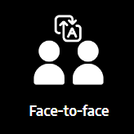
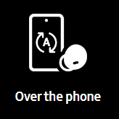
Tagging guideline
No.
1 |  | Click to "Face-to-face" in panel list
 | AA | data-omni-type="microsite_contentinter" data-omni="galaxy ai is here:face to face"
 | GA | ga-ca="content click" ga-ac="feature" ga-la="galaxy ai is here:face to face"
1
No.
2 |  | Click to “Over the phone" in panel list
 | AA | data-omni-type="microsite_contentinter" data-omni="galaxy ai is here:over the phone"
 | GA | ga-ca="content click" ga-ac="feature" ga-la="galaxy ai is here:over the phone"
2
Notes:
<!-- 1 -->
<a class="c-gen-bnr__item t-popup__call" href="#" data-popup-id="1" data-omni-type="microsite_contentinter" data-omni="im marketing page:find the best galaxy a optimized for features you need" ga-ca="im marketing page" ga-ac="feature" ga-la="find the best galaxy a optimized for features you need">
<!-- 2 -->
<a class="c-gen-bnr__item t-aconverter__btn" href="#Aconverter" data-omni-type="microsite_contentinter" data-omni="im marketing page:upgrade your current phone to the new galaxy a" ga-ca="im marketing page" ga-ac="feature" ga-la="upgrade your current phone to the new galaxy a">

